Slide 1





Image Style Transfer Using Convolutional Neural Networks
Members: Apurva Modi, Maruf Sakib, Lalita Sharkey
Notes:
Into - Lalita 1-4
Deep image representations - Apurva 5-7
Result - Maruf
Good afternoon everyone,
Our research paper that we are going to review today is about“Image Style Transfer Using Convolutional Neural Networks”. The presentation is divided into 3 sections. First, the introduction section which will be covered by me Lalita Sharkey. As for the second section, Apurva will be explaining about Deep Image Presentation. Lastly, Maruf Sakib will discussed the result of this research paper. First, Let’s start with understanding what exactly is “Image Style Transfer”

Slide 2
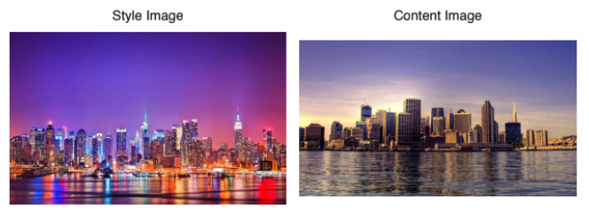
Input Images
Notes:
A style transfer is a process of modifying the style or texture of an image while still preserving its content. In this example Let’s say you like the style of image on the left but you feel like there is too much of the sky. You would like this image style to be on the content image on the right because you think the image is more proportional but very dull looking. You may wonder how will the result of transferring the image style on the left to the content image on the right looks like.

Slide 3
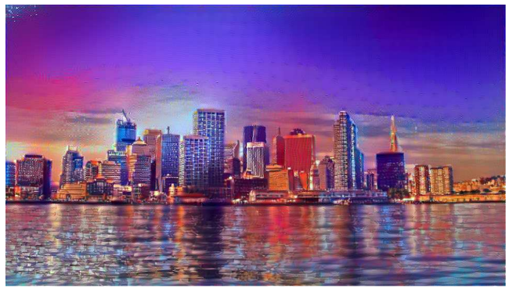
Target Result Image
Notes:
Here is the result image. After using Convolutional Neural Networks to transfer the one image style to another image content.

Slide 4
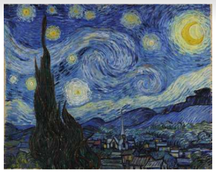
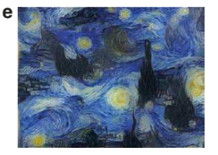
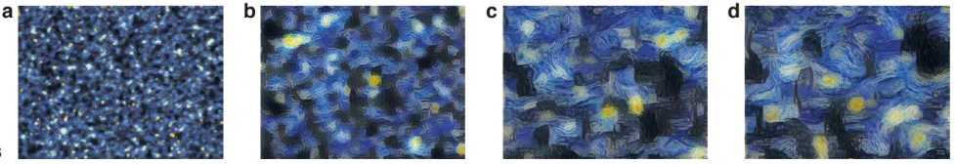
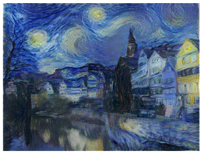
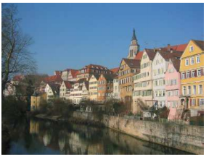
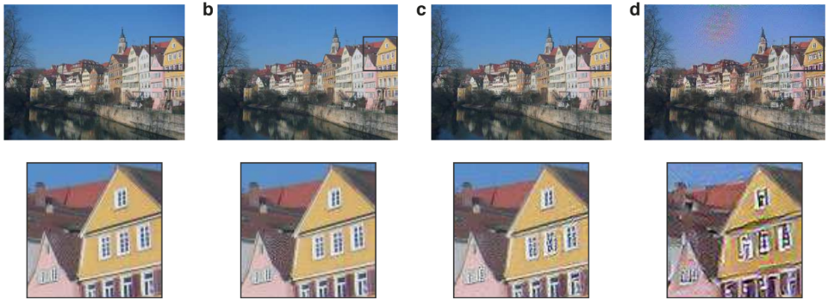
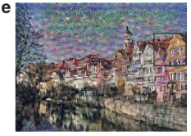
Overall Approach
Convolutional Neural Network (VGG-19)
Painting
Photograph
Notes:
The overall concept of this paper is passing an image into a pre-trained convolutional neural network. In this case it is VGG-19 network. Once an image is passed into a network, the image will then be represented in term of feature maps or we can think of it as the filtered image which are differents in each layers of the network. To distinct each layer feature map, we need to observe what particular information is preserved in that layer. In this example, there is one painting and one photograph. We extract the texture from the painting and the content from the photograph both of that in term of features of the VGG network then we generate the new image that has the content of the photograph and the texture or style from the painting.
Details of all these methods will be explained further by Apurva.
NOTE:
VGG-19 is a convolutional neural network that is trained on more than a million images from the ImageNet database. The network is 19 layers deep and can classify images into 1000 object categories, such as keyboard, mouse, pencil, and many animals. As a result, the network has learned rich feature representations for a wide range of images.

Slide 5
How is Image represented .?
Image is generated on the basis of the VGG-19 network which was trained to perform object recognition and localisation.
They normalized the network by scaling the weights such that the mean activation of each convolutional filter over images and positions is equal to one.
No fully connected layer
For image synthesis we found that replacing the maximum pooling operation by average pooling yields slightly more appealing results, which is why the images shown were generated with average pooling.
Notes:
VGG 19 model 16 convolutional layer and 5 pooling layer
re-scaling can be done for the VGG network without changing its output, because it contains only rectifying linear activation functions and no normalization or pooling over feature maps.

Slide 6
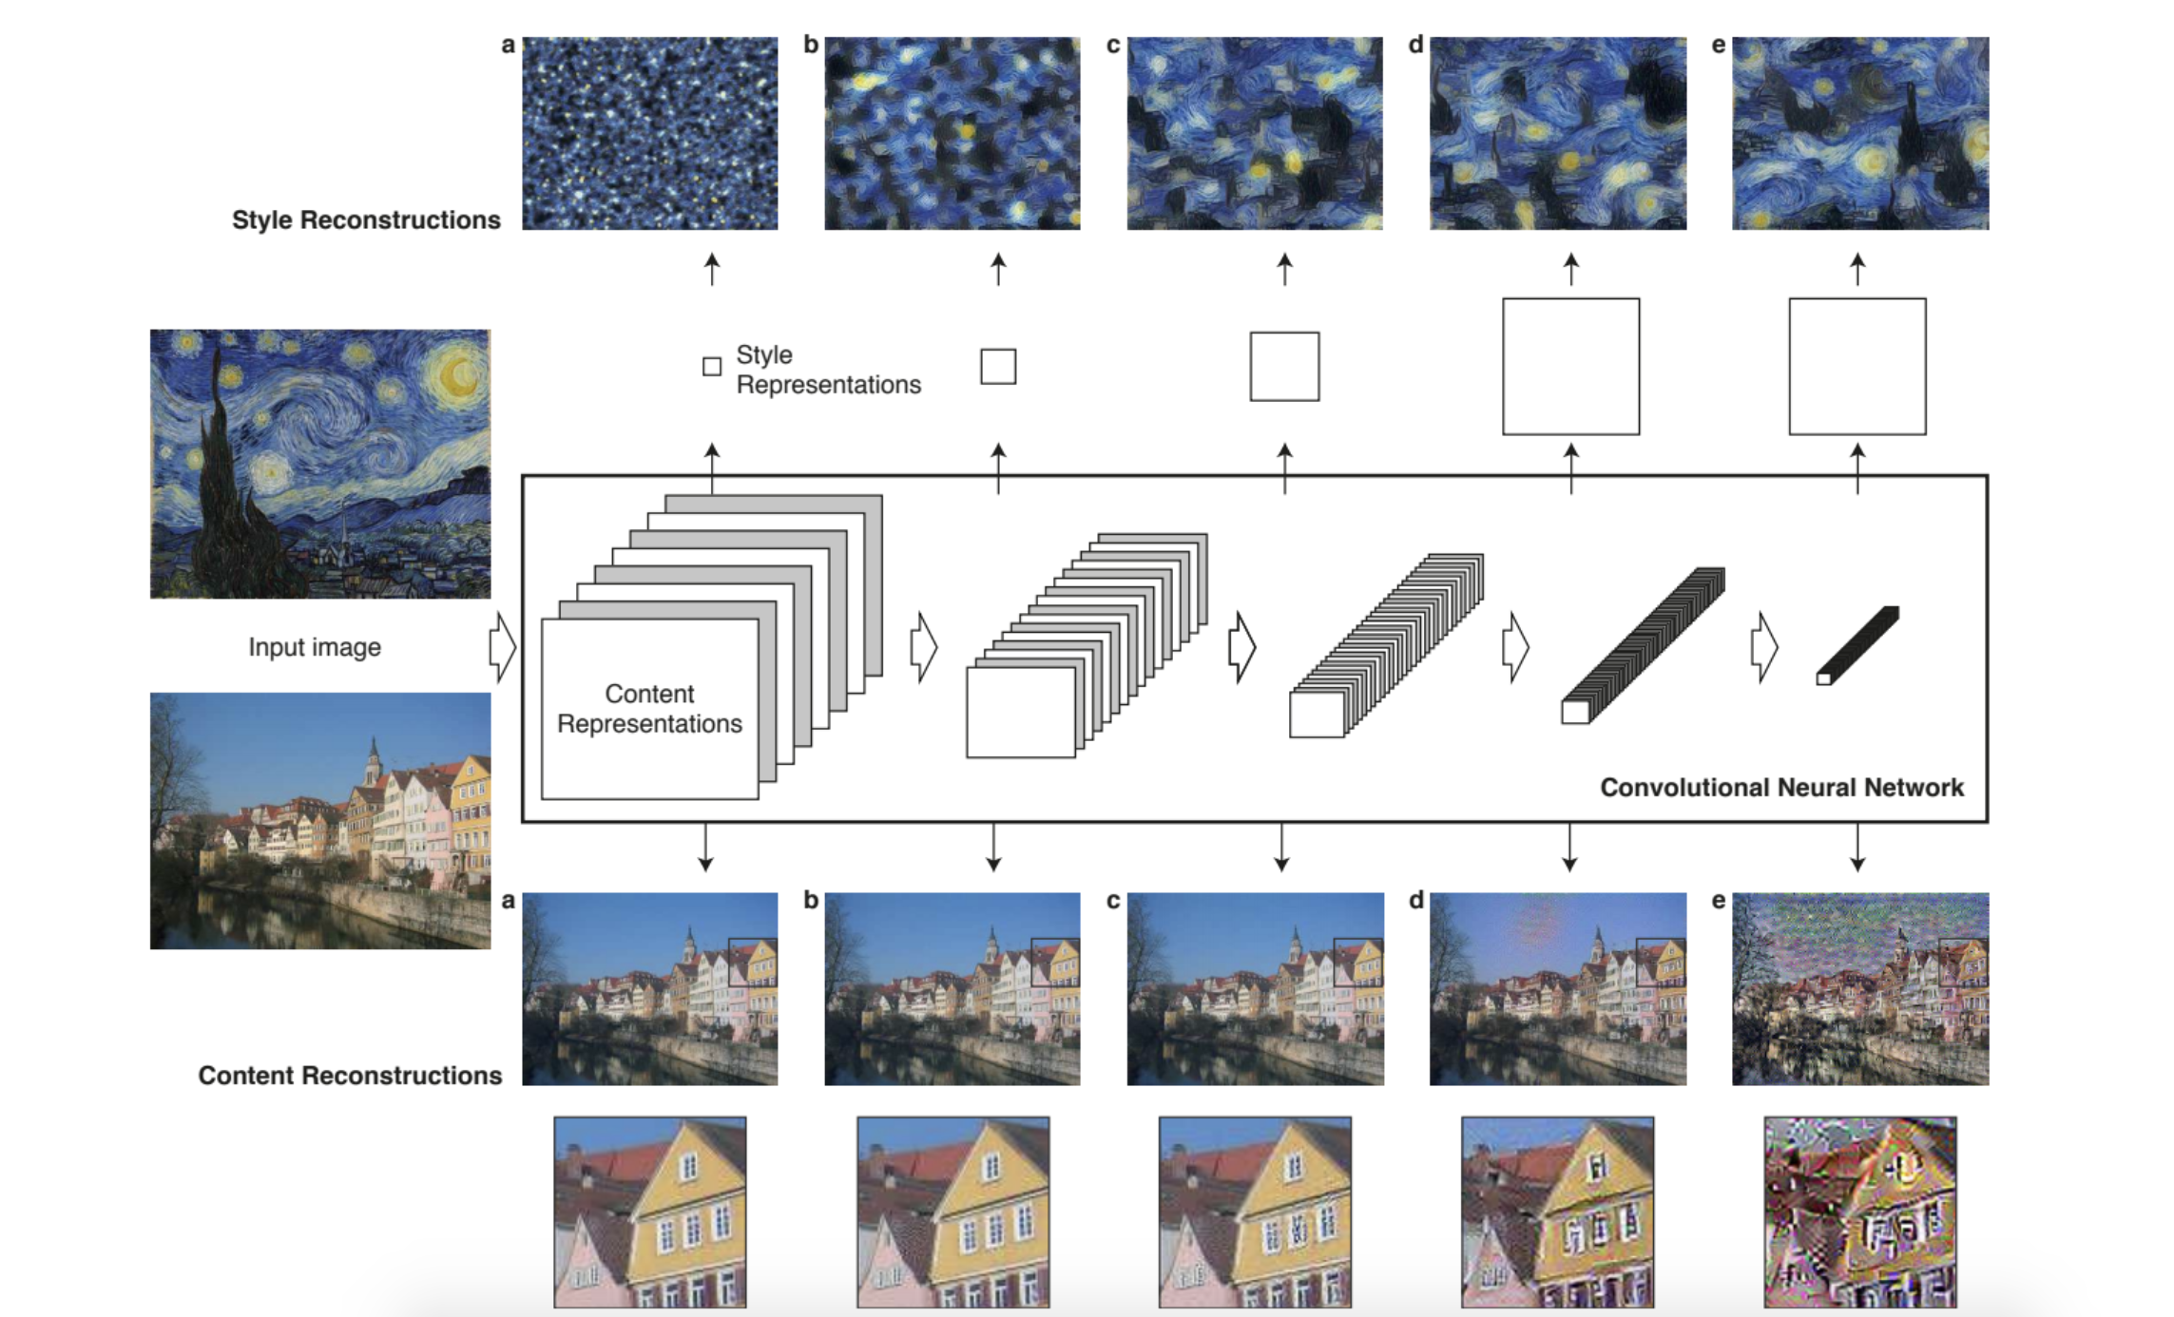

Slide 7
Content Image + Style Image = Combination

Slide 8
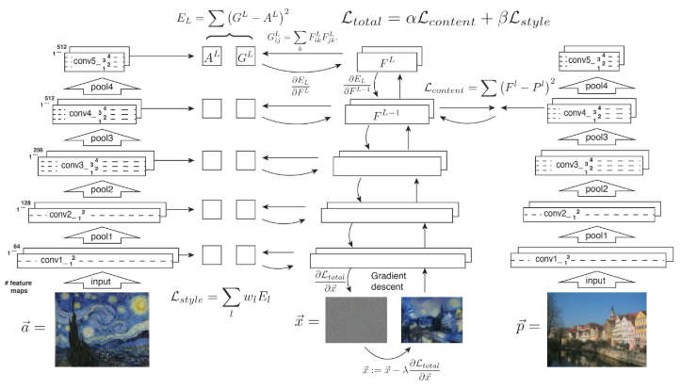
Style transfer algorithm
a = artwork
p = photograph
x = noise (combination)
l = layer
L = loss
F = content feature
Alpha beta losses
P = Content representation
G = Style feature
A = Style representation
E = Sum(G - A)²
W = weighing factor
alpha= content weight
beta=style weight
Notes:
Add legend!!
Style transfer algorithm combines a parametric texture model based on CNN with a method to invert their image representation.
a= artwork
p=photograph
x=noise (combination)
l= layer
L =loss
F Content Feature
G= noise/output representation feature
Alpha beta losses
G = ?
A = Style representation at every conv layer
P=
E =
w= weighting factor to the contribution of each layer to the total loss

Slide 9
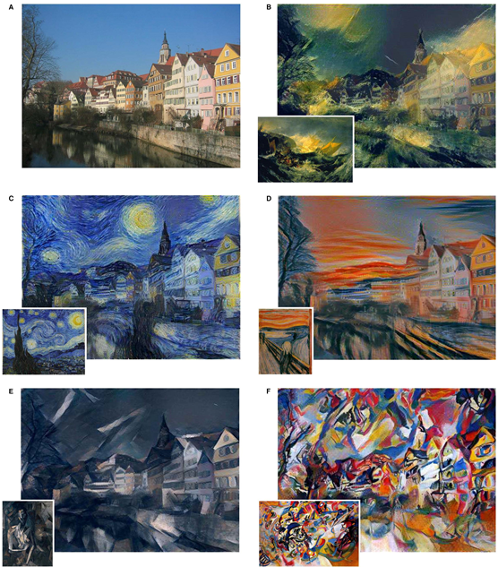
Results
Images that combine the content of a photograph with the style of several well-known artworks
Content layer: ‘conv4 2’
Style layers: ‘conv1 1’, ‘conv2 1’, ‘conv3 1’,
‘conv4 1’ and ‘conv5 1’
(using wl = 1/5 in those layers, wl = 0 in all other layers). The ratio α/β was either 1 × 10⁻³ (B), 8 × 10⁻⁴ (C), 5 × 10⁻³ (D), or 5 × 10−4 (E, F)

Slide 10
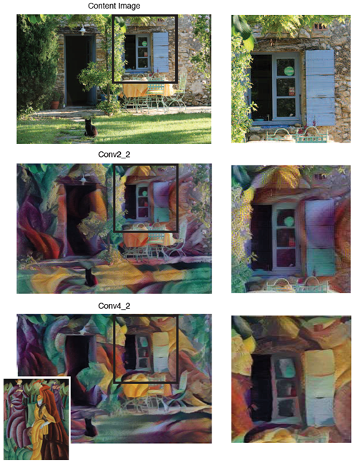
Results
Original Content
Conv2_2
Preserves much of the fine structure of the original photograph
Texture of the painting is simply blended over the photograph (middle)
Matching
Original Content
Conv4_2
Matching
Photograph is displayed in the style of the painting (bottom)
Notes:
Figure 5. The effect of matching the content representation in different layers of the network. Matching the content on layer ‘conv2 2’ preserves much of the fine structure of the original photograph and the synthesised image looks as if the texture of the painting is simply blended over the photograph (middle). When matching the content on layer ‘conv4 2’ the texture of the painting and the content of the photograph merge together such that the content of the photograph is displayed in the style of the painting (bottom). Both images were generated with the same choice of parameters
(α/β = 1 × 10−3). The painting that served as the style
image is shown in the bottom left corner and is named Jesuiten III
by Lyonel Feininger, 1915.

Slide 11
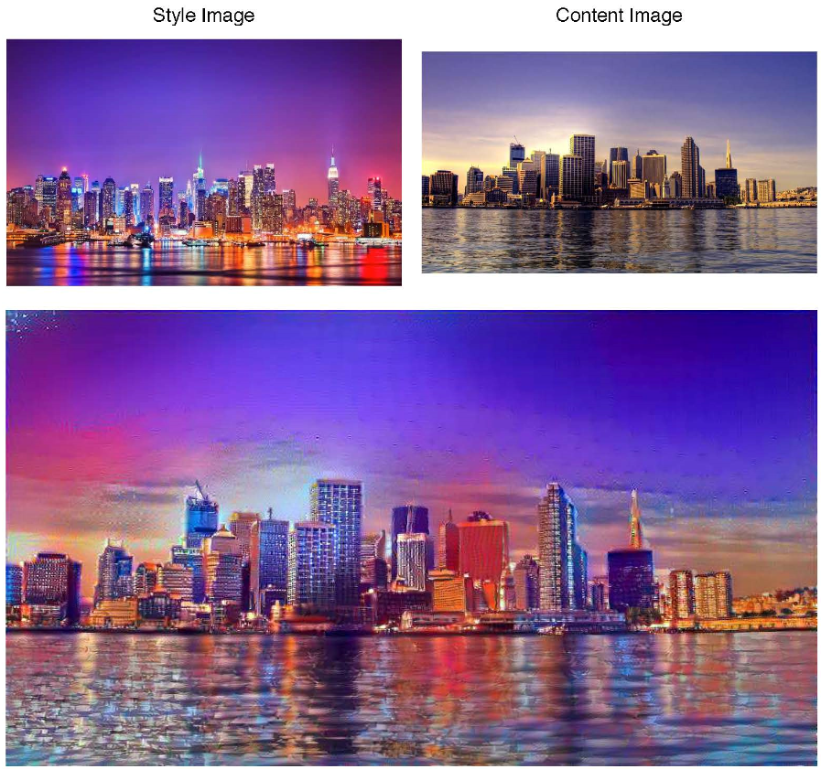
Results
Photorealistic style transfer
image synthesis was initialised from the content
image and the ratio α/β was equal to 1 × 10⁻²
Notes:
Photorealistic style transfer. The style is transferred from a photograph showing New York by night onto a picture showing London by day. The image synthesis was initialised from the content image and the ratio α/β was equal to 1 × 10−2

Slide 12
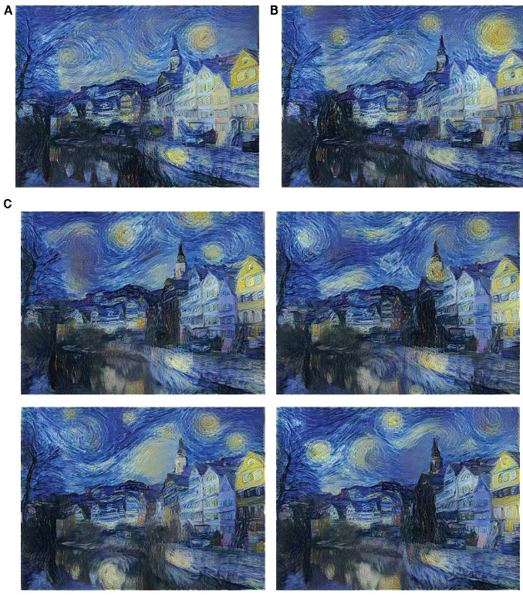
Content
Style
Thank You for Listening
Any Questions
White noise
White noise
White noise
White noise

Slide 13
Appendix

Slide 14
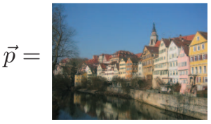
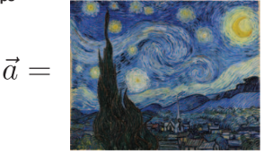
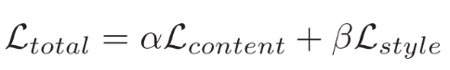
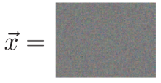
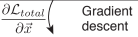
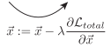
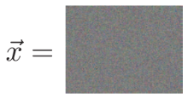
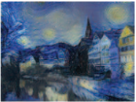
Finding Generated Image
Start with
Initiate the generated image
dimension randomly
Ex: 100 * 100 * 3
Use gradient descent to
minimize the loss function
minimize the loss function
Content image
Style image
White noise image
Result image
Notes:
Star with Content image and Style image
Randomly generate image with random pixel values
Iteratively update x vector/ result vector by subtracting vector x from the gradient of the loss function
Terminate when the result image matches with the style features of the image and content features image

Slide 15
Results
Initialisation of the gradient descent
A Initialised from the content image
B Initialised from the style image
C Four samples of images initialized from different white noise images
For all images the ratio α/β was equal to 1×10⁻³

Slide 16
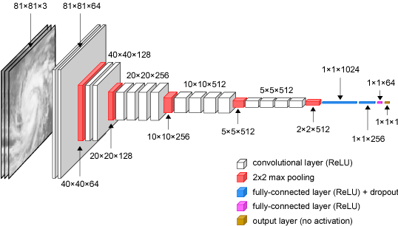
VGG - 19 Architecture

Slide 17
Loss Function
Total Loss = 𝛼 *Content Loss + 𝛽 *Style Loss
Note: 𝛼, 𝛽 = some weights
Content image
Style image
Content loss function ensures that the activations of the higher layers are similar between the content image and the generated image
Style loss function makes sure that the correlation of activations in all the layers are similar between the style image and the generated image
Result image

Slide 18
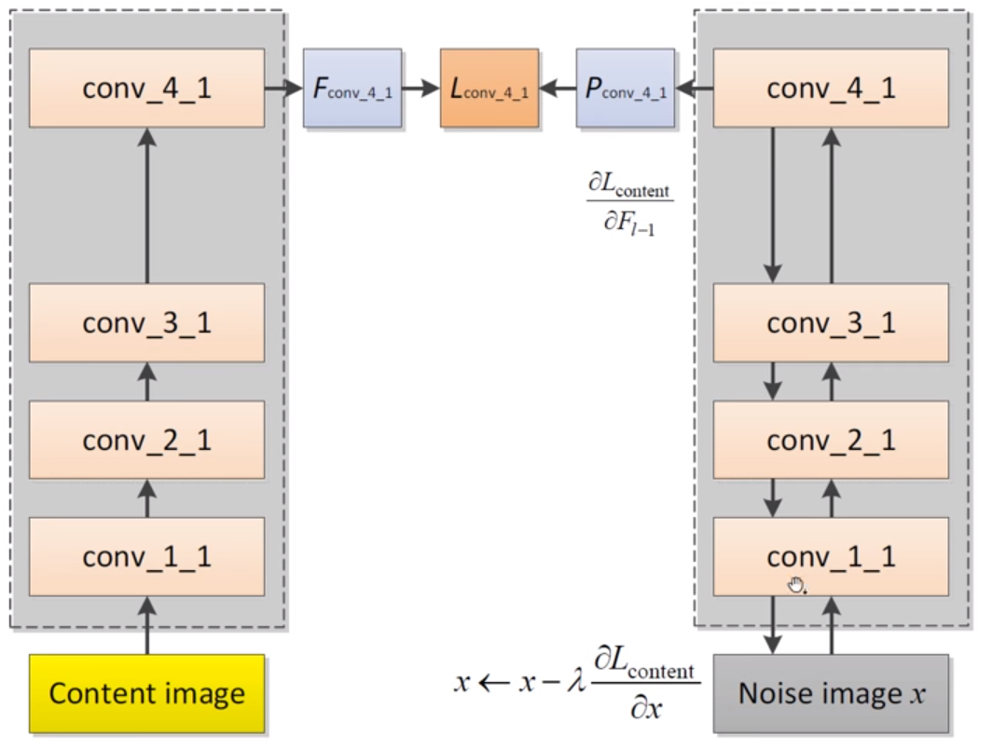
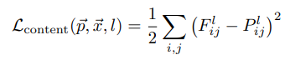
Content Loss Function
= The activation of the l th layer,
i th feature map,
jth position obtained using the generated image
= The activation of the l th layer,
i th feature map,
jth position obtained using the noise image
Content Loss captures the root mean squared error between the activations produced by the generated image and the content image
Notes:
2 images with similar activations share similar content features represented by the later in question

Slide 19
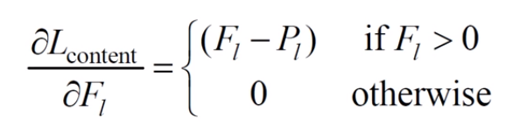
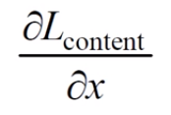
Gradient of Content Loss
Derivative of content loss in layer l:
Can be used to calculate the gradient with respect to
the image x (The output image):

Slide 20
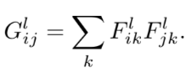
Style Extraction
Use activation of conv_1_1, conv_2_1, conv_3_1, conv_4_1, and conv_5_1
Calculate the Gram matrix from activations of each layer
Gram matrices allows detecting global repeating patterns-textures in image and be “blind” to local features

